Slide 1

Ratings Prediction Project Presentation
Submitted by
AKSHAY DINESH SHAH

Slide 2
INTRODUCTION
This is a Machine Learning Project performed on customer reviews. Reviews are processed using common NLP techniques.
Millions of people use Amazon and Flipkart to buy products. For every product, people can rate and write a review. If a product is good, it gets a positive review and gets a higher star rating, similarly, if a product is bad, it gets a negative review and lower star rating. My aim in this project is to predict star rating automatically based on the product review.
The range of star rating is 1 to 5. That means if the product review is negative, then it will get low star rating (possibly 1 or 2), if the product is average then it will get medium star rating (possibly 3), and if the product is good, then it will get higher star rating (possibly 4 or 5).
This task is similar to Sentiment Analysis, but instead of predicting the positive and negative sentiment (sometimes neutral also), here we need to predict the rating.

Slide 3
PROBLEM STATEMENT
A website has a forum for writing technical reviews of products and consists of repository of reviews for technical products. Now they are adding a new feature to their website i.e. The reviewer will have to add stars(rating) as well with the review. The rating is out 5 stars and it only has 5 options available 1 star, 2 stars, 3 stars, 4 stars, 5 stars. Now they want to predict ratings for the reviews which were written in the past and they don’t have a rating. An application to predict the rating by seeing the review is required to be built.
Therefore, a predictive model to accurately predict a user’s rating based on input review is required to be made.

Slide 4
DATA COLLECTION PHASE
You have to scrape at least 20000 rows of data. You can scrape more data as well, it’s up to you. More the data better the model. In this section you need to scrape the reviews of different laptops, Phones, Headphones, smart watches, Professional Cameras, Printers, monitors, home theatre, router from different e-commerce websites.
Basically, we need these columns:
1) reviews of the product.
2) rating of the product.
Fetch an equal number of reviews for each rating, for example if you are fetching 10000 reviews then all ratings 1,2,3,4,5 should be 2000. It will balance our data set. Convert all the ratings to their round number as there are only 5 options for rating i.e., 1,2,3,4,5. If a rating is 4.5 convert it 5.

Slide 5
The Dataset
The data set contains the training set, which has 21088 samples. All the data samples contain 2 fields which includes ‘Ratings’ and ‘Review’.
The data set includes:
Review: User review of a product.
Ratings: Corresponding user rating score for a User review

Slide 6
Python Libraries used:
Pandas: For carrying out Data Analysis, Data Manipulation, Data Cleaning etc o NumPy: For performing a variety of operations on the datasets.
matplotlib.pyplot, Seaborn: For visualizing Data and various relationships between Feature and Label Columns
sklearn for Modelling Machine learning algorithms, Evaluation metrics, Data Transformation etc
imblearn.over_sampling: To employ SMOTE technique for balancing out the classes.
re, string: To perform regex operations
Word cloud: For Data Visualization
NLTK: To use various Natural Language Processing Tools.

Slide 7
MODEL BUILDING PHASE
After collecting the data, you need to build a machine learning model. Before model building do all data pre-processing steps involving NLP. Try different models with different hyper parameters and select the best model. Follow the complete life cycle of data science. Include all the steps mentioned below:
1. Data Cleaning
2. Exploratory Data Analysis and Visualization
3. Data Pre-processing
4. Model Building
5. Model Evaluation
6. Selecting the Best classification model

Slide 8
DATA PREPROCESSING
Importing the necessary libraries/dependencies
Checking dataset dimensions and null value details
Looking at various label categories using the Unique method
Performing data cleaning and then visualization steps
Making Word Clouds for loud words in each label class
Handling the class imbalance issue manually and fixing it
Converting text into vectors using the TF-IDF Vectorizer
Splitting the dataset into train and test to build classification models
Evaluating the classification models with necessary metrics

Slide 9
Data Preprocessing Done
Rows with null values were removed.
Columns: Unnamed: 0(just a series of numbers) was dropped since it doesn't contribute to building a good model for predicting the target variable values.
The train and test dataset contents were then converted into lowercase.
Punctuations, unnecessary characters etc were removed, currency symbols, phone numbers, web urls, email addresses etc were replaced with single words
Tokens that contributed nothing to semantics of the messages were removed as Stop words. Finally retained tokens were lemmatized using WordNetLemmatizer().
The string lengths of original comments and the cleaned comments were then compared.

Slide 10
Data Inputs- Logic- Output Relationships
The comment tokens so vectorised using TfidVectorizer are input and the corresponding rating is predicted based on their context as output by classification models.
The comment content made available in Dataset is assumed to be written in English Language in the standard Greco-Roman script. This is so that the Stop word package and WordNetLemmatizer can be effectively used

Slide 11
Hardware and Software Requirements and Tools Used
Hardware Used:
Processor: Intel i5 10th Generation
Physical Memory: 8.0GB (3200MHz)
GPU: Nvidia RTX 3060 ,4GB DDR6 VRAM.
Software Used:
Windows 11 Operating System

Slide 12

Exploratory Data Analysis Visualizations
Barplots, Countplots, Distplots, WordClouds were used to visualize the data of all the columns and their relationships with Target variable.

Slide 13
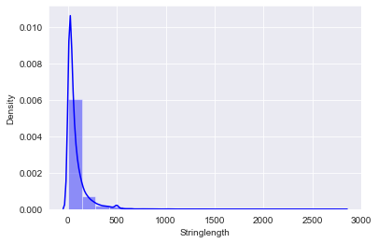
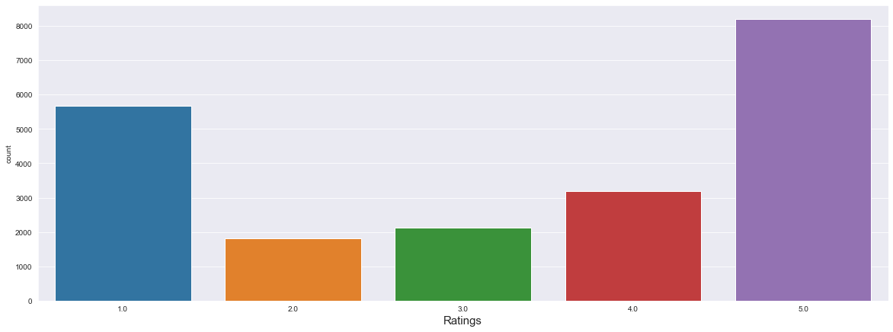
The rating classes 1.0-4.0 are fairly balanced, the 5.0 class represents the highest number of reviews.

Slide 14
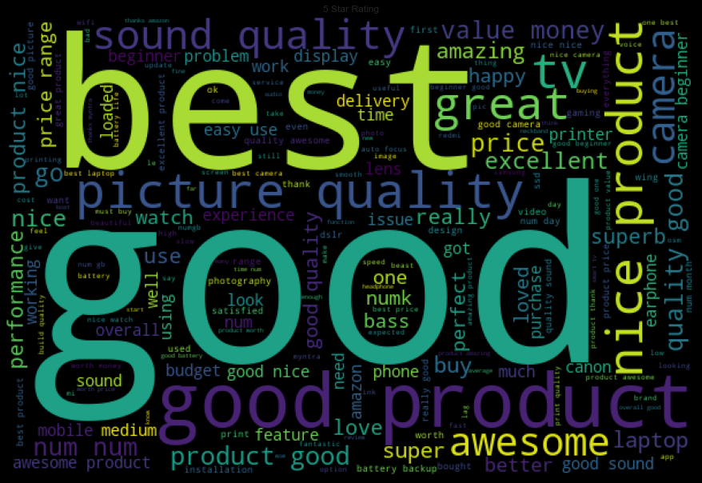
Word Clouds of the most frequent words under used in reviews for Rating ‘5’

Slide 15
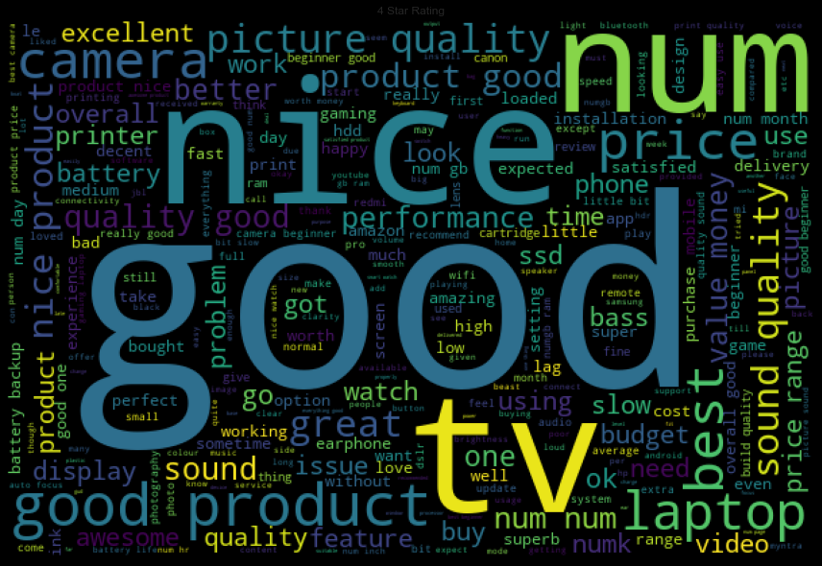
Word Clouds of the most frequent words under used in reviews for Rating ‘4’

Slide 16
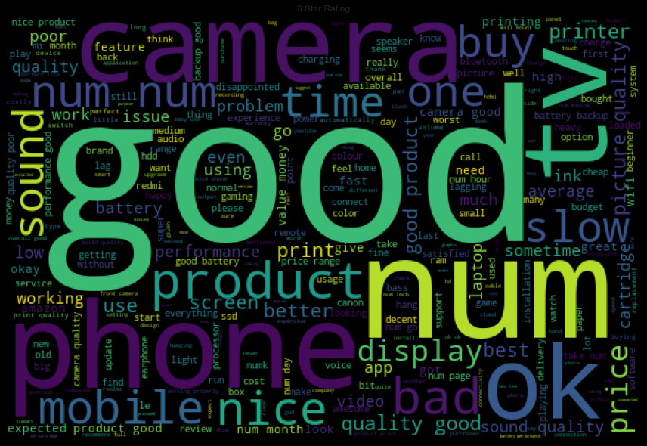
Word Clouds of the most frequent words under used in reviews for Rating ‘3’

Slide 17
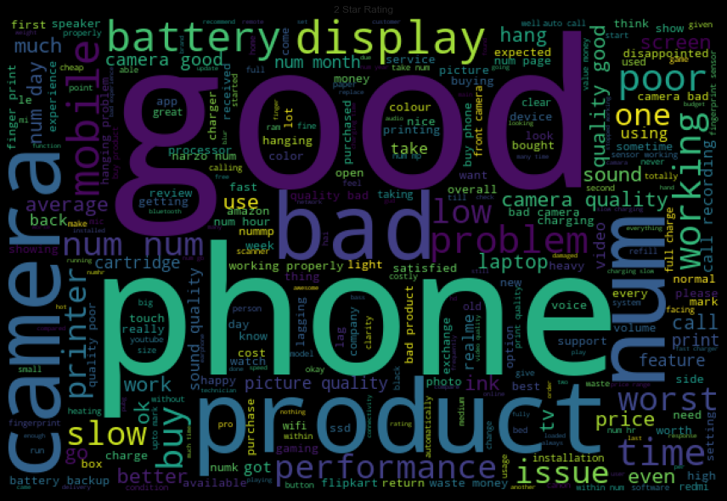
Word Clouds of the most frequent words under used in reviews for Rating ‘2’

Slide 18
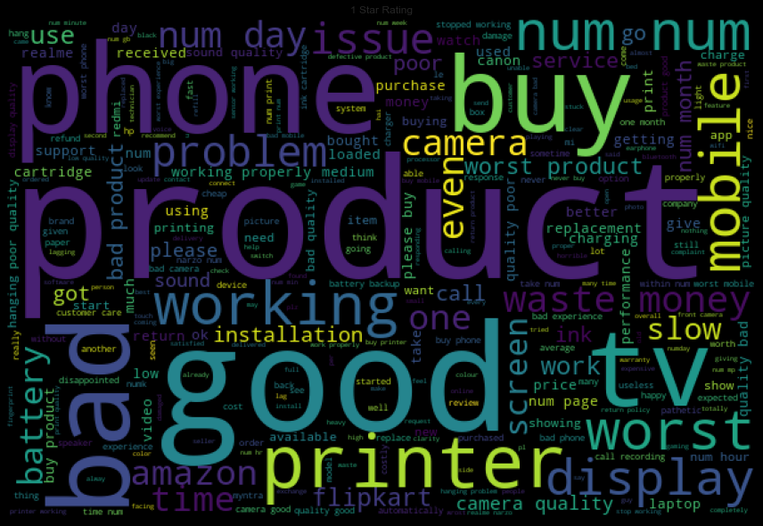
Word Clouds of the most frequent words under used in reviews for Rating ‘1’

Slide 19
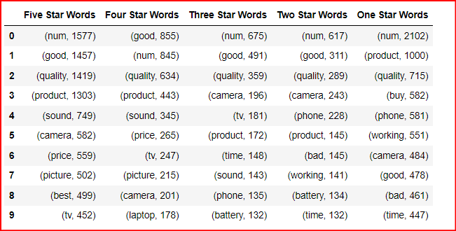
Top 10 words and their corresponding Ratings, along with their counts

Slide 20
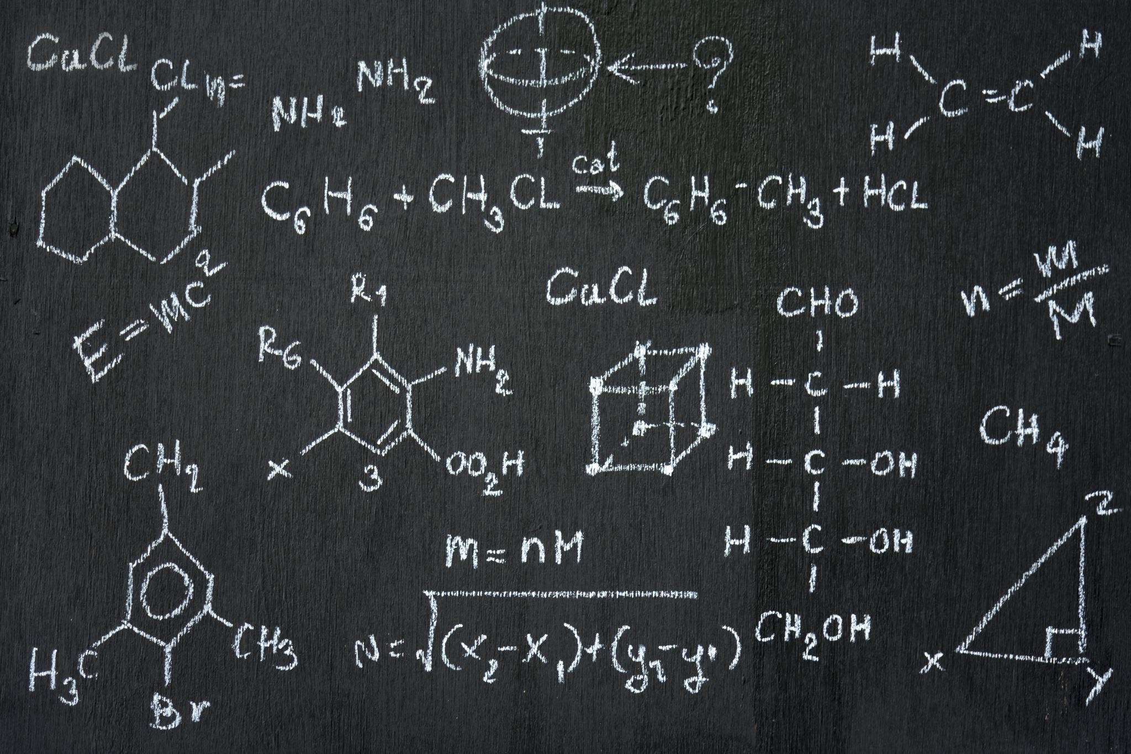
MODEL DEVELOPMENT ALGORITHMS
The complete list of algorithms that were used in training and testing the classification model are listed below:
Logistic Regression
Random Forest Classifier
MultinomialNB
XGB Classifier
AdaBoostClassifier
ComplementNB
PassiveAggressiveClassifier

Slide 21
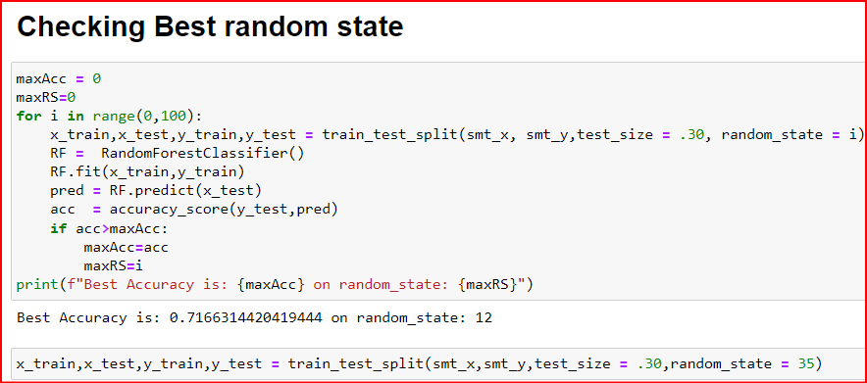
Train-Test Split

Slide 22
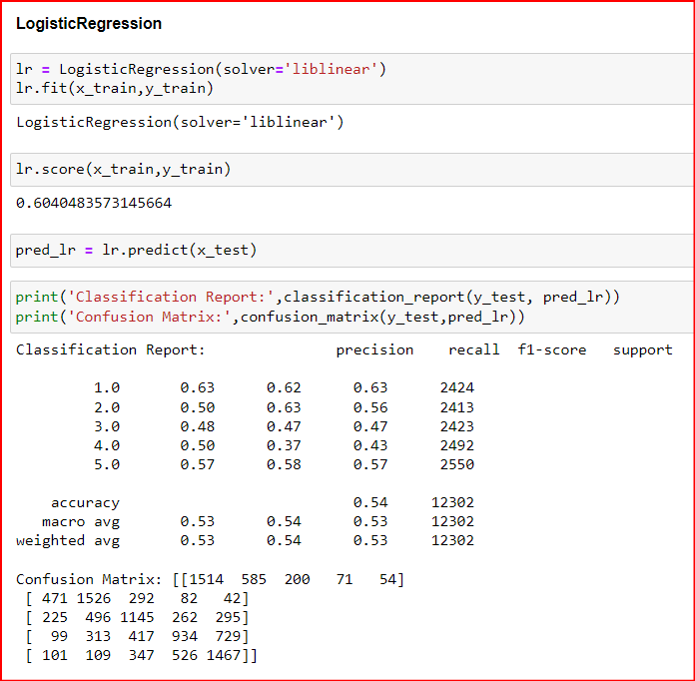
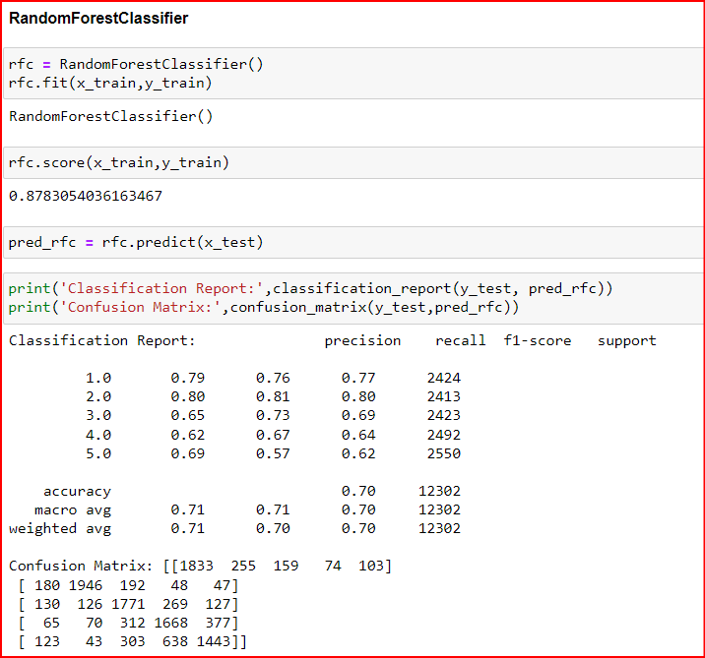
Model

Slide 23
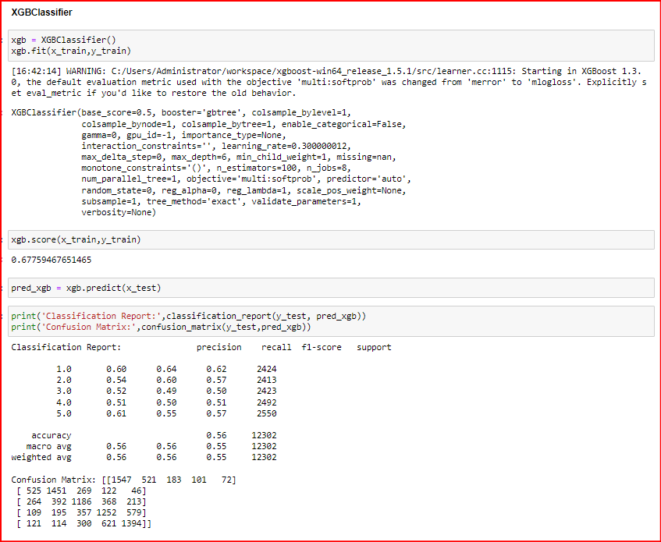

Slide 24
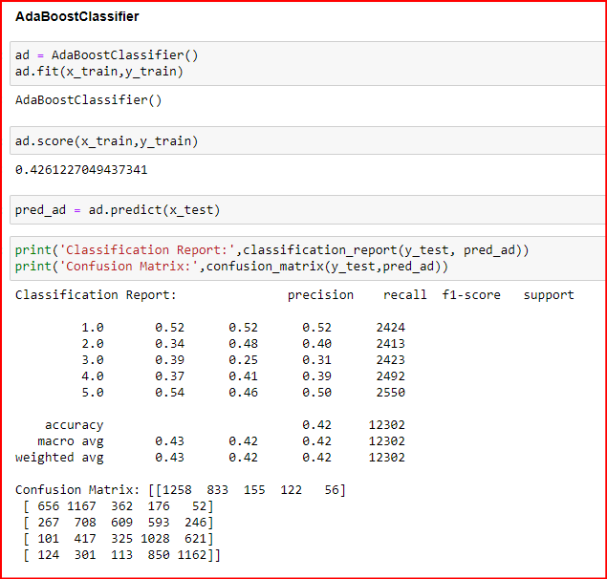
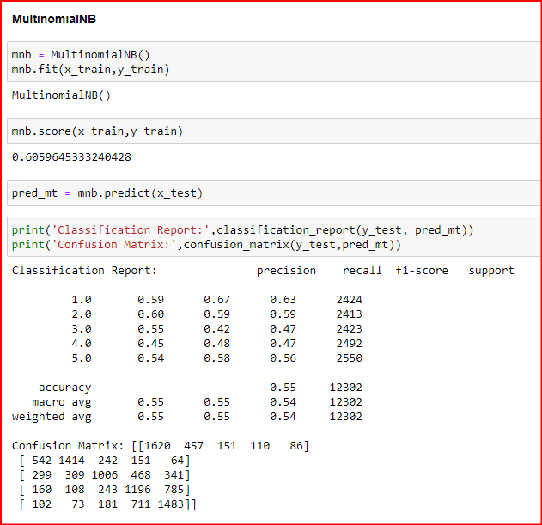

Slide 25
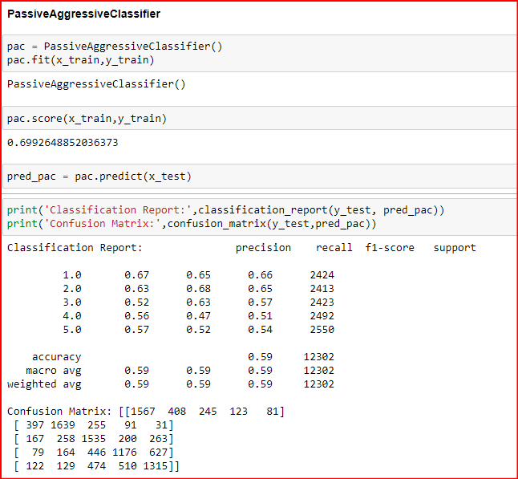
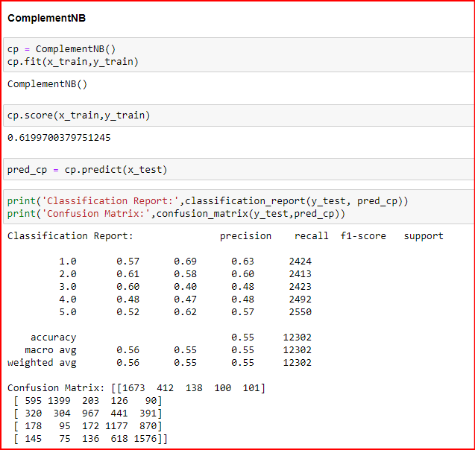

Slide 26
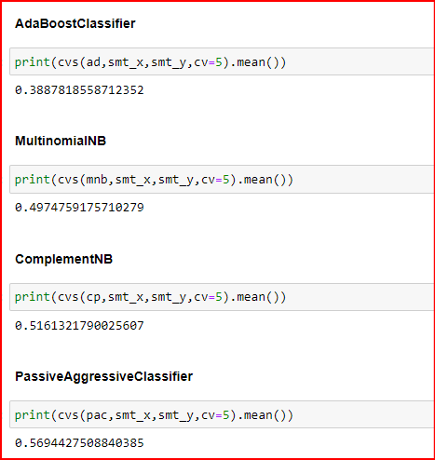
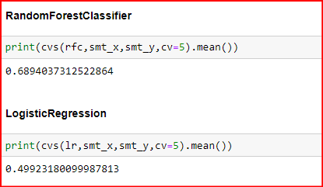
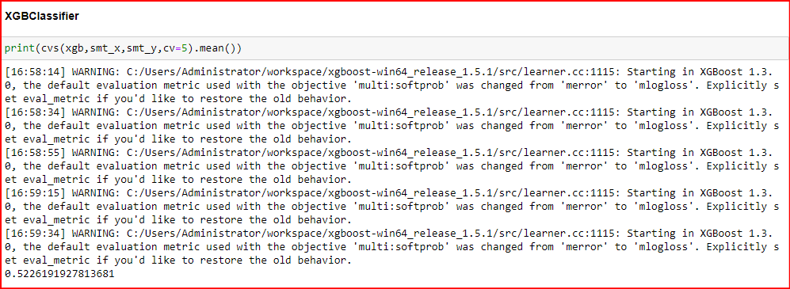
Cross Validation

Slide 27
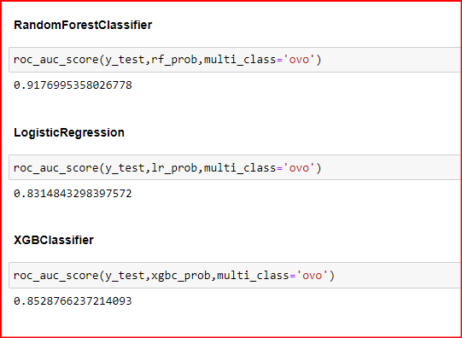
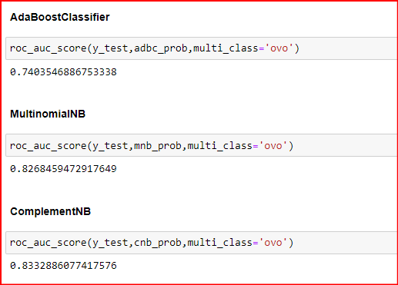
ROC AUC Scores

Slide 28
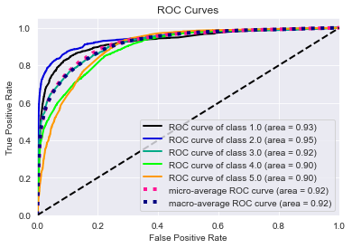
ROC AUC curve for Random Forest Classifier

Slide 29
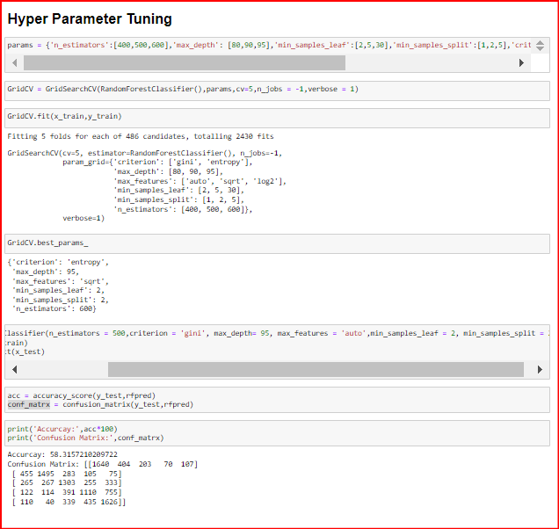
Hyper Parameter Tuning

Slide 30
CONCLUSION
Key findings of the study: In this project I have collected data of reviews and ratings for different products from amazon.in and flipkart.com. Then I have done different text processing for reviews column and chose equal number of text from each rating class to eliminate problem of imbalance. By doing different EDA steps I have analyzed the text. We have checked frequently occurring words in our data as well as rarely occurring words. After all these steps I have built function to train and test different algorithms and using various evaluation metrics I have selected Random Forest Classifier as our final model. Finally, by doing hyperparameter tuning we got optimum parameters for our final model. And finally, we got improved accuracy score for our final model.
Limitations of this work and scope for the future work: As we know the content of text in reviews is totally depends on the reviewer and they may rate differently which is totally depends on that person. So, it is difficult to predict ratings based on the reviews with higher accuracies. Still, we can improve our accuracy by fetching more data and by doing extensive hyperparameter tuning.

Slide 31

CONCLUSION
Areas of improvement:
Less time complexity
More computational power can be given
More accurate reviews can be given
Many more permutations and combinations in hyper parameter tuning can be used to obtain better parameter list
We were able to create a rating prediction model that can be used to identify rating details just by evaluating the comments posted by a customer.

Slide 32
THANK YOU

